Slide 1

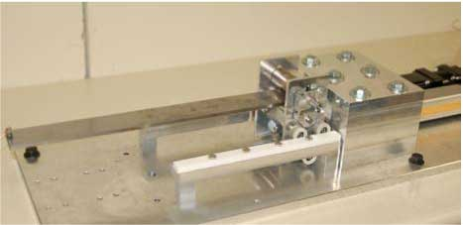
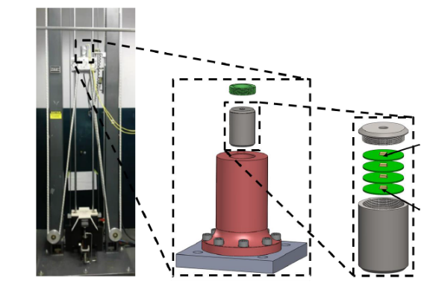
dropbear dataset overview
Matthew Nelsonª, Simon Laflammeª, Adriane Moura^{b}, Jacob Dodson^{c}
Department of Civil, Construction, and Environmental Engineering
Applied Research Associates, Inc., Emerald Coast Division
(c) Air Force Research Laboratory, Munitions Directorate, Fuzes Branch, Eglin Air Force Base, FL, USA

Slide 2
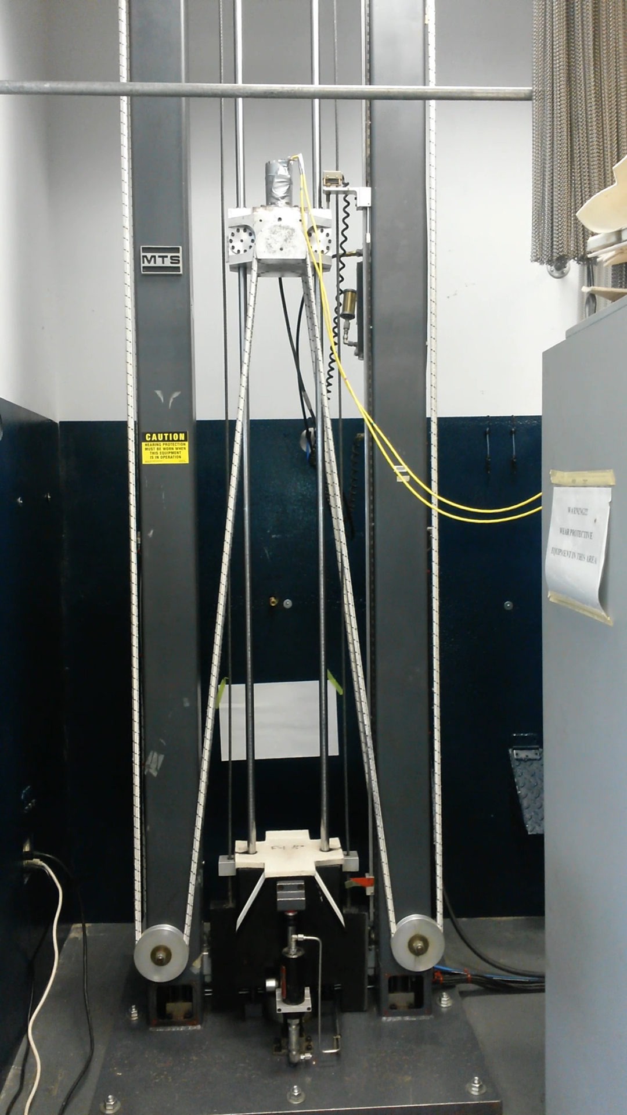
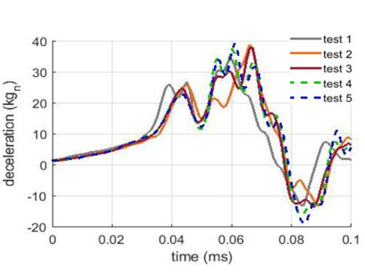
High-Rate Overview
High-Rate Overview
Benchmark
Applications
Datasets
Definition
Large uncertainties in the external loads.
High levels of nonstationarity and heavy disturbance.
Generations of unmodeled dynamics from changes in mechanical configuration.
Objective
Create benchmark to evaluate algorithms capable of performing structural health monitoring for high-rate systems

Slide 3
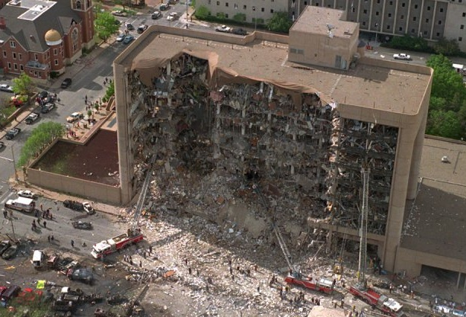



High-Rate Overview
High-Rate Overview
Benchmark
Applications
Datasets
Examples
10 kg TNT takes 0.3 ms to 100 ms to travel over 1 to 40 m distance
Mach 5 corresponds to 1.5 km/s (0.93 mi/s) – passenger aircrafts at Mach 0.8
1 ms at Mach 5 is 1.5 m. 1.5 MHz sampling gives a 1 mm resolution.

Slide 4
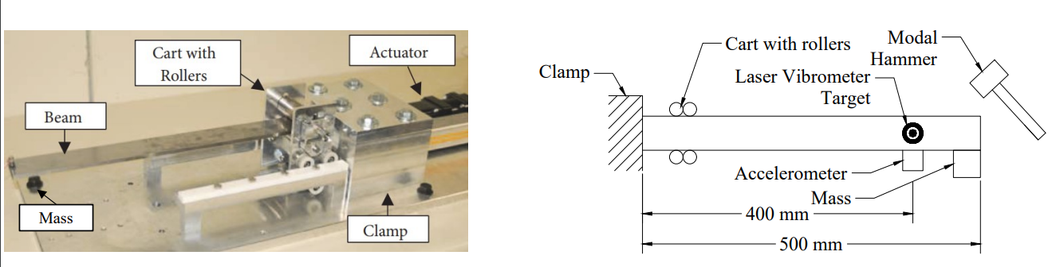
Benchmark
High-Rate Overview
Benchmark
Applications
Datasets
DROPBEAR
DROPBEAR (Dynamic Reproduction of Projectiles in Ballistic Environments for Advanced Research)
Dimensions - L: 500 mm (19.82 in), W: 50 mm (2 in), T: 6.4 mm (0.25 in)
Available sensors:
Accelerometer (PCB 353B17)
Strain Gauge (GF 164, 10 mA, 350 Ohm)
Laser Vibrometer
Extensometer
Linear Transducer (SPS-L225-HALS)
Available excitations:
Static or dynamic cart action
Single or multiple modal hammer impacts
Electromagnet mass

Slide 5
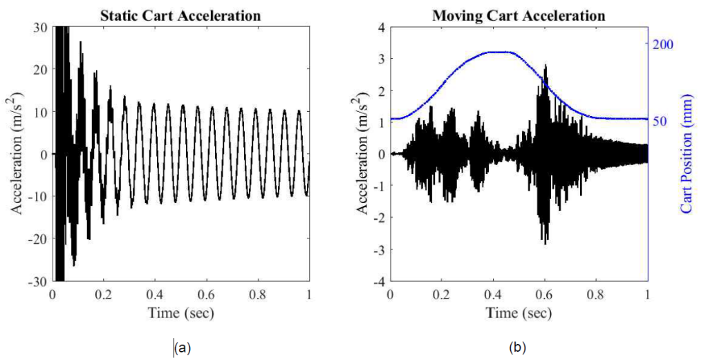
Benchmark
High-Rate Overview
Benchmark
Applications
Datasets
Data collection
Modal Hammer: PCB 086C01
Cart: servo-controlled rolling cart
Data collection: Precision Filters 28000 signal conditioner and was recorded
using National Instruments PXI NI 6133 card combination.
The strain gauges used a Precision Filters 28144 card with 2 wire constant current excitation
Accelerometers and modal hammer used a Precision Filters 28304 IEPE card

Slide 6
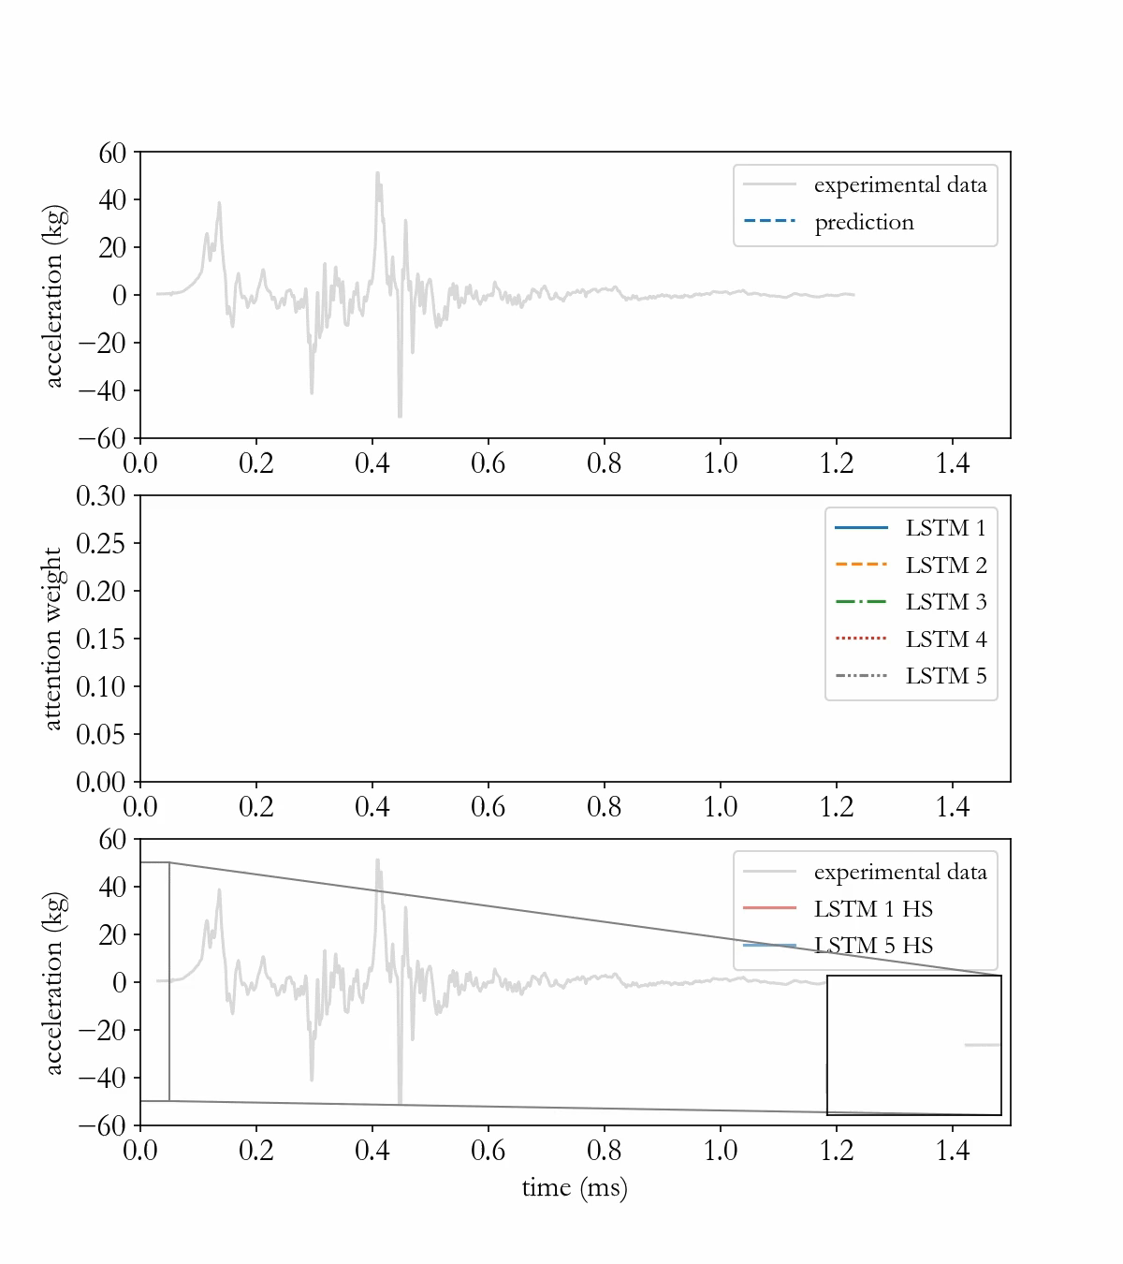
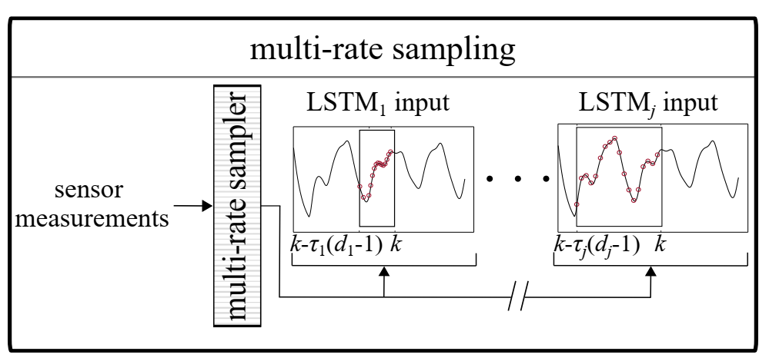
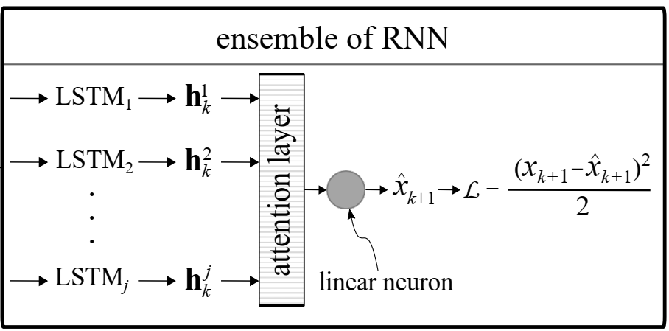
Applications
High-Rate Overview
Benchmark
Applications
Datasets
Time Series Modeling – ensemble of recurrent neural networks
Goal:
Predict acceleration using data-driven methods

Slide 7
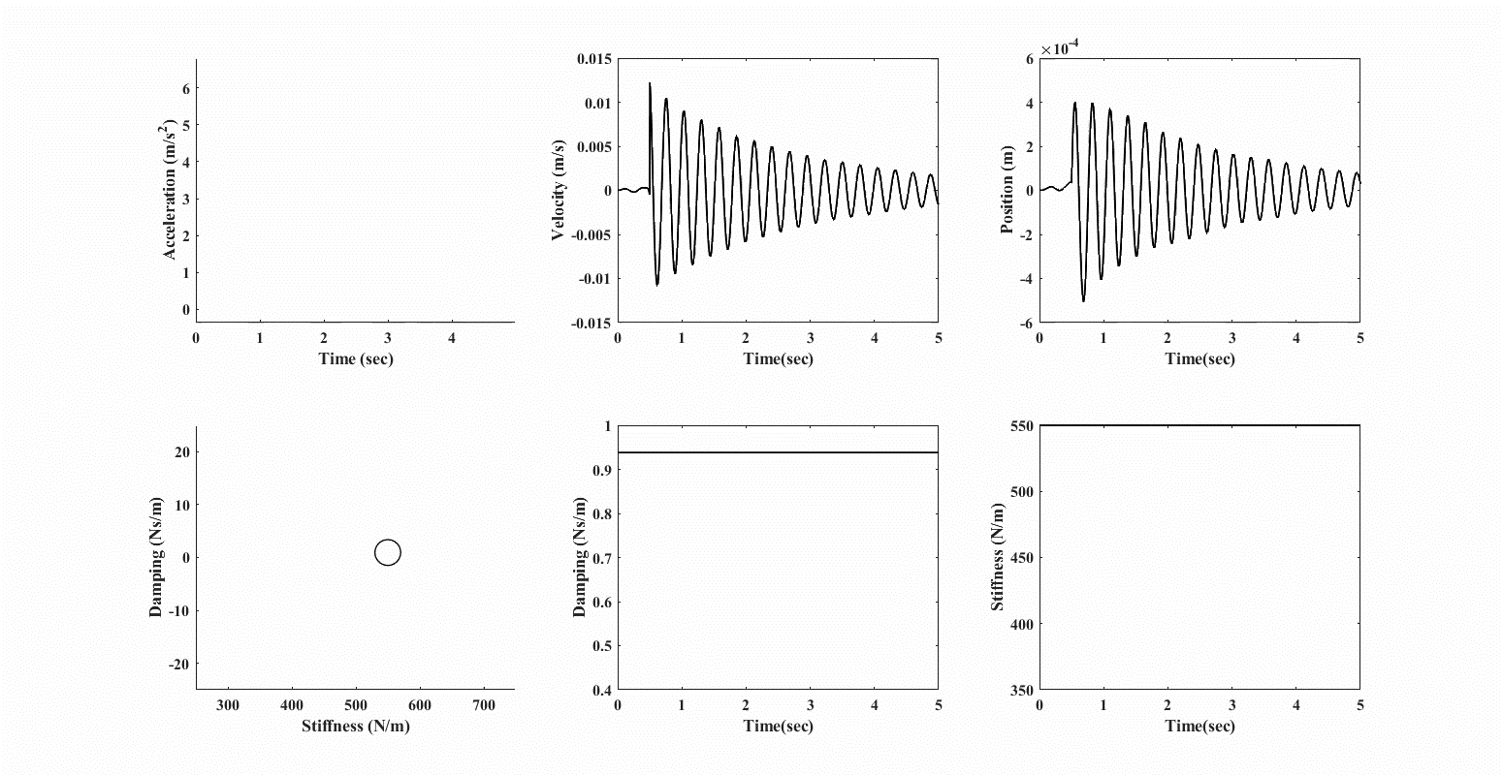
Applications
High-Rate Overview
Benchmark
Applications
Datasets
State estimation – model reference adaptive system
Goal:
From acceleration input estimate the system’s velocity, position, damping, and stiffness using physics-based methods

Slide 8
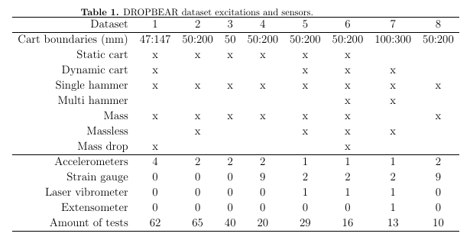
Datasets
High-Rate Overview
Benchmark
Applications
Datasets
Summary

Slide 9
Datasets
High-Rate Overview
Benchmark
Applications
Datasets
Dataset 1 – Sensors
Sensors:
4x Accelerometer (PCB 353B17)
SN 139378 – 200 mm
SN 127691 – 300 mm
SN 139351 – 400 mm
SN 127687 – 500 mm
Sampling frequency: 25,600 samples/s
Excitation notes
Single hammer impact to begin test 500 mm from clamp

Slide 10
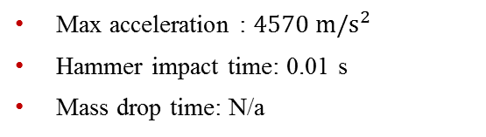
Datasets
High-Rate Overview
Benchmark
Applications
Datasets
Dataset 1 – test 1
Excitations:
Static cart action (47 mm)
Single hammer impact
Electromagnet mass
Max acceleration : $4570 m/s^{2}$
Hammer impact time: 0.01 s
Mass drop time: N/a

Slide 11
Datasets
High-Rate Overview
Benchmark
Applications
Datasets
Dataset 1 – test 2
Excitations:
Static cart action (47 mm)
Single hammer impact
Electromagnet mass
Max acceleration : $4570 m/s^{2}$
Hammer impact time: 0.01 s
Mass drop time: N/a

Slide 12

Datasets
High-Rate Overview
Benchmark
Applications
Datasets
Dataset 1 – test 3
Excitations:
Static cart action (47 mm)
Single hammer impact
Electromagnet mass
Max acceleration : $2890 m/s^{2}$
Hammer impact time: 1.00 s
Mass drop time: N/a

Slide 13

Datasets
High-Rate Overview
Benchmark
Applications
Datasets
Dataset 1 – test 4
Excitations:
Static cart action (47 mm)
Single hammer impact
Electromagnet mass
Max acceleration : $3970 m/s^{2}$
Hammer impact time: 0.01 s
Mass drop time: N/a

Slide 14

Datasets
High-Rate Overview
Benchmark
Applications
Datasets
Dataset 1 – test 5
Excitations:
Static cart action (47 mm)
Single hammer impact
Electromagnet mass
Max acceleration : $3970 m/s^{2}$
Hammer impact time: 1.00 s
Mass drop time: N/a

Slide 15

Datasets
High-Rate Overview
Benchmark
Applications
Datasets
Dataset 1 – test 6
Excitations:
Static cart action (47 mm)
Single hammer impact
Electromagnet mass
Max acceleration : $2020 m/s^{2}$
Hammer impact time: 0.01 s
Mass drop time: N/a

Slide 16

Datasets
High-Rate Overview
Benchmark
Applications
Datasets
Dataset 1 – test 7
Excitations:
Static cart action (47 mm)
Single hammer impact
Electromagnet mass
Max acceleration : $2020 m/s^{2}$
Hammer impact time: 1.00 s
Mass drop time: N/a

Slide 17

Datasets
High-Rate Overview
Benchmark
Applications
Datasets
Dataset 1 – test 8
Excitations:
Static cart action (47 mm)
Single hammer impact
Electromagnet mass
Max acceleration : $3840 m/s^{2}$
Hammer impact time: 0.01 s
Mass drop time: N/a

Slide 18

Datasets
High-Rate Overview
Benchmark
Applications
Datasets
Dataset 1 – test 9
Excitations:
Static cart action (47 mm)
Single hammer impact
Electromagnet mass
Max acceleration : $3470 m/s^{2}$
Hammer impact time: 1.00 s
Mass drop time: N/a

Slide 19

Datasets
High-Rate Overview
Benchmark
Applications
Datasets
Dataset 1 – test 10
Excitations:
Static cart action (47 mm)
Single hammer impact
Electromagnet mass
Max acceleration : $3950 m/s^{2}$
Hammer impact time: 0.01 s
Mass drop time: N/a

Slide 20

Datasets
High-Rate Overview
Benchmark
Applications
Datasets
Dataset 1 – test 11
Excitations:
Dynamic cart action (47-147 mm)
Single hammer impact
Electromagnet mass drop
Max acceleration : $4570 m/s^{2}$
Hammer impact time: 0.01 s
Mass drop time: 4.38 s

Slide 21

Datasets
High-Rate Overview
Benchmark
Applications
Datasets
Dataset 1 – test 12
Excitations:
Dynamic cart action (47-147 mm)
Single hammer impact
Electromagnet mass drop
Max acceleration : $4890 m/s^{2}$
Hammer impact time: 0.01 s
Mass drop time: 4.00 s

Slide 22

Datasets
High-Rate Overview
Benchmark
Applications
Datasets
Dataset 1 – test 13
Excitations:
Dynamic cart action (47-147 mm)
Single hammer impact
Electromagnet mass drop
Max acceleration : $4470 m/s^{2}$
Hammer impact time: 0.01 s
Mass drop time: 4.60 s

Slide 23

Datasets
High-Rate Overview
Benchmark
Applications
Datasets
Dataset 1 – test 14
Excitations:
Static cart action (47 mm)
Single hammer impact
Electromagnet mass
Max acceleration : $4440 m/s^{2}$
Hammer impact time: 0.01 s
Mass drop time: N/a

Slide 24

Datasets
High-Rate Overview
Benchmark
Applications
Datasets
Dataset 1 – test 15
Excitations:
Static cart action (47 mm)
Single hammer impact
Electromagnet mass
Max acceleration : $4550 m/s^{2}$
Hammer impact time: 0.01 s
Mass drop time: N/a

Slide 25

Datasets
High-Rate Overview
Benchmark
Applications
Datasets
Dataset 1 – test 16
Excitations:
Static cart action (47 mm)
Single hammer impact
Electromagnet mass
Max acceleration : $4070 m/s^{2}$
Hammer impact time: 2.54 s
Mass drop time: N/a

Slide 26

Datasets
High-Rate Overview
Benchmark
Applications
Datasets
Dataset 1 – test 17
Excitations:
Static cart action (47 mm)
Single hammer impact
Electromagnet mass drop
Max acceleration : $4700 m/s^{2}$
Hammer impact time: 0.01 s
Mass drop time: 3.89 s

Slide 27
Datasets
High-Rate Overview
Benchmark
Applications
Datasets
Dataset 1 – test 18
Excitations:
Static cart action (47 mm)
Single hammer impact
Electromagnet mass drop
Max acceleration : $4700 m/s^{2}$
Hammer impact time: 0.01 s
Mass drop time: 3.89 s

Slide 28

Datasets
High-Rate Overview
Benchmark
Applications
Datasets
Dataset 1 – test 19
Excitations:
Static cart action (47 mm)
Single hammer impact
Electromagnet mass drop
Max acceleration : $4570 m/s^{2}$
Hammer impact time: 0.01 s
Mass drop time: 3.42 s

Slide 29

Datasets
High-Rate Overview
Benchmark
Applications
Datasets
Dataset 1 – test 20
Excitations:
Dynamic cart action (47-147 mm)
Single hammer impact
Electromagnet mass drop
Max acceleration : $3130 m/s^{2}$
Hammer impact time: 0.01 s
Mass drop time: 3.48 s

Slide 30

Datasets
High-Rate Overview
Benchmark
Applications
Datasets
Dataset 1 – test 21
Excitations:
Dynamic cart action (47-147 mm)
Single hammer impact
Electromagnet mass drop
Max acceleration : $4730 m/s^{2}$
Hammer impact time: 0.01 s
Mass drop time: 3.39 s

Slide 31

Datasets
High-Rate Overview
Benchmark
Applications
Datasets
Dataset 1 – test 21
Excitations:
Dynamic cart action (47-147 mm)
Single hammer impact
Electromagnet mass drop
Max acceleration : $4700 m/s^{2}$
Hammer impact time: 0.01 s
Mass drop time: 4.22 s

Slide 32

Datasets
High-Rate Overview
Benchmark
Applications
Datasets
Dataset 1 – test 23
Excitations:
Static cart action (47 mm)
Single hammer impact
Electromagnet mass
Max acceleration : $4310 m/s^{2}$
Hammer impact time: 0.01 s
Mass drop time: N/a

Slide 33

Datasets
High-Rate Overview
Benchmark
Applications
Datasets
Dataset 1 – test 24
Excitations:
Static cart action (47 mm)
Single hammer impact
Electromagnet mass
Max acceleration : $4380 m/s^{2}$
Hammer impact time: 0.01 s
Mass drop time: N/a

Slide 34

Datasets
High-Rate Overview
Benchmark
Applications
Datasets
Dataset 1 – test 25
Excitations:
Static cart action (47 mm)
Single hammer impact
Electromagnet mass
Max acceleration : $4830 m/s^{2}$
Hammer impact time: 0.01 s
Mass drop time: N/a

Slide 35

Datasets
High-Rate Overview
Benchmark
Applications
Datasets
Dataset 1 – test 26
Excitations:
Static cart action (47 mm)
Single hammer impact
Electromagnet mass drop
Max acceleration : $4600 m/s^{2}$
Hammer impact time: 0.01 s
Mass drop time: 4.05 s

Slide 36

Datasets
High-Rate Overview
Benchmark
Applications
Datasets
Dataset 1 – test 27
Excitations:
Static cart action (47 mm)
Single hammer impact
Electromagnet mass drop
Max acceleration : $4890 m/s^{2}$
Hammer impact time: 0.01 s
Mass drop time: 3.91 s

Slide 37

Datasets
High-Rate Overview
Benchmark
Applications
Datasets
Dataset 1 – test 28
Excitations:
Static cart action (47 mm)
Single hammer impact
Electromagnet mass drop
Max acceleration : $4890 m/s^{2}$
Hammer impact time: 0.01 s
Mass drop time: 3.51 s

Slide 38

Datasets
High-Rate Overview
Benchmark
Applications
Datasets
Dataset 1 – test 29
Excitations:
Dynamic cart action (47-147 mm)
Single hammer impact
Electromagnet mass drop
Max acceleration : $4890 m/s^{2}$
Hammer impact time: 0.01 s
Mass drop time: 3.55 s

Slide 39

Datasets
High-Rate Overview
Benchmark
Applications
Datasets
Dataset 1 – test 30
Excitations:
Dynamic cart action (47-147 mm)
Single hammer impact
Electromagnet mass drop
Max acceleration : $4620 m/s^{2}$
Hammer impact time: 0.01 s
Mass drop time: 4.10 s

Slide 40

Datasets
High-Rate Overview
Benchmark
Applications
Datasets
Dataset 1 – test 31
Excitations:
Dynamic cart action (47-147 mm)
Single hammer impact
Electromagnet mass drop
Max acceleration : $4200 m/s^{2}$
Hammer impact time: 0.01 s
Mass drop time: 3.63 s

Slide 41

Datasets
High-Rate Overview
Benchmark
Applications
Datasets
Dataset 1 – test 32
Excitations:
Static cart action (47 mm)
Single hammer impact
Electromagnet mass
Max acceleration : $4730 m/s^{2}$
Hammer impact time: 0.01 s
Mass drop time: N/a

Slide 42
Datasets
High-Rate Overview
Benchmark
Applications
Datasets
Dataset 1 – test 33
Excitations:
Static cart action (47 mm)
Single hammer impact
Electromagnet mass
Max acceleration : $4730 m/s^{2}$
Hammer impact time: 0.01 s
Mass drop time: N/a

Slide 43
Datasets
High-Rate Overview
Benchmark
Applications
Datasets
Dataset 1 – test 34
Excitations:
Static cart action (47 mm)
Single hammer impact
Electromagnet mass
Max acceleration : $4830 m/s^{2}$
Hammer impact time: 0.01 s
Mass drop time: N/a

Slide 44

Datasets
High-Rate Overview
Benchmark
Applications
Datasets
Dataset 1 – test 35
Excitations:
Static cart action (47 mm)
Single hammer impact
Electromagnet mass drop
Max acceleration : $4730 m/s^{2}$
Hammer impact time: 0.01 s
Mass drop time: 4.19

Slide 45

Datasets
High-Rate Overview
Benchmark
Applications
Datasets
Dataset 1 – test 36
Excitations:
Static cart action (47 mm)
Single hammer impact
Electromagnet mass drop
Max acceleration : $4150 m/s^{2}$
Hammer impact time: 0.01 s
Mass drop time: 3.84

Slide 46

Datasets
High-Rate Overview
Benchmark
Applications
Datasets
Dataset 1 – test 37
Excitations:
Static cart action (47 mm)
Single hammer impact
Electromagnet mass drop
Max acceleration : $3750 m/s^{2}$
Hammer impact time: 0.01 s
Mass drop time: 3.84

Slide 47

Datasets
High-Rate Overview
Benchmark
Applications
Datasets
Dataset 1 – test 38
Excitations:
Dynamic cart action (47-147 mm)
Single hammer impact
Electromagnet mass drop
Max acceleration : $4890 m/s^{2}$
Hammer impact time: 0.01 s
Mass drop time: 3.24 s

Slide 48

Datasets
High-Rate Overview
Benchmark
Applications
Datasets
Dataset 1 – test 39
Excitations:
Dynamic cart action (47-147 mm)
Single hammer impact
Electromagnet mass drop
Max acceleration : $4890 m/s^{2}$
Hammer impact time: 0.01 s
Mass drop time: 3.20 s

Slide 49

Datasets
High-Rate Overview
Benchmark
Applications
Datasets
Dataset 1 – test 40
Excitations:
Dynamic cart action (47-147 mm)
Single hammer impact
Electromagnet mass drop
Max acceleration : $4570 m/s^{2}$
Hammer impact time: 0.01 s
Mass drop time: 3.22 s

Slide 50

Datasets
High-Rate Overview
Benchmark
Applications
Datasets
Dataset 1 – test 41
Excitations:
Static cart action (47 mm)
Single hammer impact
Electromagnet mass
Max acceleration : $4670 m/s^{2}$
Hammer impact time: 0.01 s
Mass drop time: N/a

Slide 51

Datasets
High-Rate Overview
Benchmark
Applications
Datasets
Dataset 1 – test 42
Excitations:
Static cart action (47 mm)
Single hammer impact
Electromagnet mass
Max acceleration : $918 m/s^{2}$
Hammer impact time: 0.01 s
Mass drop time: N/a

Slide 52

Datasets
High-Rate Overview
Benchmark
Applications
Datasets
Dataset 1 – test 43
Excitations:
Static cart action (47 mm)
Single hammer impact
Electromagnet mass
Max acceleration : $775 m/s^{2}$
Hammer impact time: 0.01 s
Mass drop time: N/a

Slide 53

Datasets
High-Rate Overview
Benchmark
Applications
Datasets
Dataset 1 – test 44
Excitations:
Static cart action (47 mm)
Single hammer impact
Electromagnet mass
Max acceleration : $1820 m/s^{2}$
Hammer impact time: 0.01 s
Mass drop time: N/a

Slide 54

Datasets
High-Rate Overview
Benchmark
Applications
Datasets
Dataset 1 – test 45
Excitations:
Static cart action (47 mm)
Single hammer impact
Electromagnet mass
Max acceleration : $1700 m/s^{2}$
Hammer impact time: 0.01 s
Mass drop time: N/a

Slide 55

Datasets
High-Rate Overview
Benchmark
Applications
Datasets
Dataset 1 – test 46
Excitations:
Static cart action (47 mm)
Single hammer impact
Electromagnet mass
Max acceleration : $2450 m/s^{2}$
Hammer impact time: 0.01 s
Mass drop time: N/a

Slide 56

Datasets
High-Rate Overview
Benchmark
Applications
Datasets
Dataset 1 – test 47
Excitations:
Static cart action (47 mm)
Single hammer impact
Electromagnet mass drop
Max acceleration : $1110 m/s^{2}$
Hammer impact time: 1.00 s
Mass drop time: 4.07 s

Slide 57

Datasets
High-Rate Overview
Benchmark
Applications
Datasets
Dataset 1 – test 48
Excitations:
Static cart action (47 mm)
Single hammer impact
Electromagnet mass
Max acceleration : $920 m/s^{2}$
Hammer impact time: 1.00 s
Mass drop time: N/a

Slide 58

Datasets
High-Rate Overview
Benchmark
Applications
Datasets
Dataset 1 – test 49
Excitations:
Static cart action (47 mm)
Single hammer impact
Electromagnet mass
Max acceleration : $1310 m/s^{2}$
Hammer impact time: 1.00 s
Mass drop time: N/a

Slide 59

Datasets
High-Rate Overview
Benchmark
Applications
Datasets
Dataset 1 – test 50
Excitations:
Static cart action (47 mm)
Single hammer impact
Electromagnet mass
Max acceleration : $1260 m/s^{2}$
Hammer impact time: 1.00 s
Mass drop time: N/a

Slide 60

Datasets
High-Rate Overview
Benchmark
Applications
Datasets
Dataset 1 – test 51
Excitations:
Static cart action (47 mm)
Single hammer impact
Electromagnet mass drop
Max acceleration : $4570 m/s^{2}$
Hammer impact time: 1.00 s
Mass drop time: 4.08

Slide 61

Datasets
High-Rate Overview
Benchmark
Applications
Datasets
Dataset 1 – test 52
Excitations:
Static cart action (47 mm)
Single hammer impact
Electromagnet mass
Max acceleration : $1780 m/s^{2}$
Hammer impact time: 1.00 s
Mass drop time: N/a

Slide 62

Datasets
High-Rate Overview
Benchmark
Applications
Datasets
Dataset 1 – test 53
Excitations:
Static cart action (47 mm)
Single hammer impact
Electromagnet mass
Max acceleration : $1360 m/s^{2}$
Hammer impact time: 1.00 s
Mass drop time: N/a

Slide 63

Datasets
High-Rate Overview
Benchmark
Applications
Datasets
Dataset 1 – test 54
Excitations:
Static cart action (47 mm)
Single hammer impact
Electromagnet mass drop
Max acceleration : $4510 m/s^{2}$
Hammer impact time: 1.00 s
Mass drop time: 4.51 s

Slide 64

Datasets
High-Rate Overview
Benchmark
Applications
Datasets
Dataset 1 – test 55
Excitations:
Static cart action (47 mm)
Single hammer impact
Electromagnet mass
Max acceleration : $4230 m/s^{2}$
Hammer impact time: 1.00 s
Mass drop time: N/a

Slide 65

Datasets
High-Rate Overview
Benchmark
Applications
Datasets
Dataset 1 – test 56
Excitations:
Static cart action (47 mm)
Single hammer impact
Electromagnet mass drop
Max acceleration : $4570 m/s^{2}$
Hammer impact time: 1.00 s
Mass drop time: 4.06 s

Slide 66

Datasets
High-Rate Overview
Benchmark
Applications
Datasets
Dataset 1 – test 57
Excitations:
Static cart action (47 mm)
Single hammer impact
Electromagnet mass
Max acceleration : $4220 m/s^{2}$
Hammer impact time: 1.00 s
Mass drop time: N/a

Slide 67

Datasets
High-Rate Overview
Benchmark
Applications
Datasets
Dataset 1 – test 58
Excitations:
Static cart action (47 mm)
Single hammer impact
Electromagnet mass
Max acceleration : $2960 m/s^{2}$
Hammer impact time: 1.00 s
Mass drop time: N/a

Slide 68

Datasets
High-Rate Overview
Benchmark
Applications
Datasets
Dataset 1 – test 59
Excitations:
Static cart action (47 mm)
Single hammer impact
Electromagnet mass
Max acceleration : $4570 m/s^{2}$
Hammer impact time: 1.00 s
Mass drop time: N/a

Slide 69

Datasets
High-Rate Overview
Benchmark
Applications
Datasets
Dataset 1 – test 60
Excitations:
Static cart action (47 mm)
Single hammer impact
Electromagnet mass
Max acceleration : $4310 m/s^{2}$
Hammer impact time: 1.00 s
Mass drop time: N/a

Slide 70

Datasets
High-Rate Overview
Benchmark
Applications
Datasets
Dataset 1 – test 61
Excitations:
Static cart action (47 mm)
Single hammer impact
Electromagnet mass
Max acceleration : $4650 m/s^{2}$
Hammer impact time: 1.00 s
Mass drop time: N/a

Slide 71

Datasets
High-Rate Overview
Benchmark
Applications
Datasets
Dataset 1 – test 62
Excitations:
Static cart action (47 mm)
Single hammer impact
Electromagnet mass
Max acceleration : $4420 m/s^{2}$
Hammer impact time: 1.00 s
Mass drop time: N/a

Slide 72
Datasets
High-Rate Overview
Benchmark
Applications
Datasets
Dataset 2 – Sensors
Sensors:
4x Accelerometer (PCB 353B17)
SN 127691 – 300 mm
SN 139351 – 400 mm
Sampling frequency: 25,600 samples/s
Excitation notes
Single hammer impact to begin test 500 mm from clamp
Mass remains for whole test duration

Slide 73

Datasets
High-Rate Overview
Benchmark
Applications
Datasets
Dataset 2 – test 1
Excitations:
Static cart action (50 mm)
Single hammer impact
Electromagnet mass
Max acceleration : $1087 m/s^{2}$
Hammer impact time: 1.00 s
Mass drop time: N/a

Slide 74

Datasets
High-Rate Overview
Benchmark
Applications
Datasets
Dataset 2 – test 2
Excitations:
Static cart action (50 mm)
Single hammer impact
Electromagnet mass
Max acceleration : $1448 m/s^{2}$
Hammer impact time: 1.00 s
Mass drop time: N/a

Slide 75

Datasets
High-Rate Overview
Benchmark
Applications
Datasets
Dataset 2 – test 3
Excitations:
Static cart action (50 mm)
Single hammer impact
Electromagnet mass
Max acceleration : $1547 m/s^{2}$
Hammer impact time: 1.00 s
Mass drop time: N/a

Slide 76

Datasets
High-Rate Overview
Benchmark
Applications
Datasets
Dataset 2 – test 4
Excitations:
Static cart action (50 mm)
Single hammer impact
Electromagnet mass
Max acceleration : $1869 m/s^{2}$
Hammer impact time: 1.00 s
Mass drop time: N/a

Slide 77

Datasets
High-Rate Overview
Benchmark
Applications
Datasets
Dataset 2 – test 5
Excitations:
Static cart action (50 mm)
Single hammer impact
Electromagnet mass
Max acceleration : $1107 m/s^{2}$
Hammer impact time: 1.00 s
Mass drop time: N/a

Slide 78

Datasets
High-Rate Overview
Benchmark
Applications
Datasets
Dataset 2 – test 6
Excitations:
Static cart action (100 mm)
Single hammer impact
Electromagnet mass
Max acceleration : $1139 m/s^{2}$
Hammer impact time: 1.00 s
Mass drop time: N/a

Slide 79

Datasets
High-Rate Overview
Benchmark
Applications
Datasets
Dataset 2 – test 7
Excitations:
Static cart action (100 mm)
Single hammer impact
Electromagnet mass
Max acceleration : $718 m/s^{2}$
Hammer impact time: 1.00 s
Mass drop time: N/a

Slide 80

Datasets
High-Rate Overview
Benchmark
Applications
Datasets
Dataset 2 – test 8
Excitations:
Static cart action (100 mm)
Single hammer impact
Electromagnet mass
Max acceleration : $1288 m/s^{2}$
Hammer impact time: 1.00 s
Mass drop time: N/a

Slide 81

Datasets
High-Rate Overview
Benchmark
Applications
Datasets
Dataset 2 – test 9
Excitations:
Static cart action (100 mm)
Single hammer impact
Electromagnet mass
Max acceleration : $1291 m/s^{2}$
Hammer impact time: 1.00 s
Mass drop time: N/a

Slide 82

Datasets
High-Rate Overview
Benchmark
Applications
Datasets
Dataset 2 – test 10
Excitations:
Static cart action (100 mm)
Single hammer impact
Electromagnet mass
Max acceleration : $1036 m/s^{2}$
Hammer impact time: 1.00 s
Mass drop time: N/a

Slide 83

Datasets
High-Rate Overview
Benchmark
Applications
Datasets
Dataset 2 – test 11
Excitations:
Static cart action (150 mm)
Single hammer impact
Electromagnet mass
Max acceleration : $1359 m/s^{2}$
Hammer impact time: 1.00 s
Mass drop time: N/a

Slide 84
Datasets
High-Rate Overview
Benchmark
Applications
Datasets
Dataset 2 – test 12
Excitations:
Static cart action (150 mm)
Single hammer impact
Electromagnet mass
Max acceleration : $1359 m/s^{2}$
Hammer impact time: 1.00 s
Mass drop time: N/a

Slide 85

Datasets
High-Rate Overview
Benchmark
Applications
Datasets
Dataset 2 – test 13
Excitations:
Static cart action (150 mm)
Single hammer impact
Electromagnet mass
Max acceleration : $1571 m/s^{2}$
Hammer impact time: 1.00 s
Mass drop time: N/a

Slide 86

Datasets
High-Rate Overview
Benchmark
Applications
Datasets
Dataset 2 – test 14
Excitations:
Static cart action (150 mm)
Single hammer impact
Electromagnet mass
Max acceleration : $765 m/s^{2}$
Hammer impact time: 1.00 s
Mass drop time: N/a

Slide 87
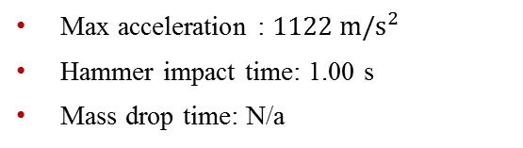
Datasets
High-Rate Overview
Benchmark
Applications
Datasets
Dataset 2 – test 15
Excitations:
Static cart action (150 mm)
Single hammer impact
Electromagnet mass
Max acceleration : $1122 m/s^{2}$
Hammer impact time: 1.00 s
Mass drop time: N/a

Slide 88

Datasets
High-Rate Overview
Benchmark
Applications
Datasets
Dataset 2 – test 16
Excitations:
Static cart action (200 mm)
Single hammer impact
Electromagnet mass
Max acceleration : $1238 m/s^{2}$
Hammer impact time: 1.00 s
Mass drop time: N/a

Slide 89

Datasets
High-Rate Overview
Benchmark
Applications
Datasets
Dataset 2 – test 17
Excitations:
Static cart action (200 mm)
Single hammer impact
Electromagnet mass
Max acceleration : $1657 m/s^{2}$
Hammer impact time: 1.00 s
Mass drop time: N/a

Slide 90

Datasets
High-Rate Overview
Benchmark
Applications
Datasets
Dataset 2 – test 18
Excitations:
Static cart action (200 mm)
Single hammer impact
Electromagnet mass
Max acceleration : $1495 m/s^{2}$
Hammer impact time: 1.00 s
Mass drop time: N/a

Slide 91

Datasets
High-Rate Overview
Benchmark
Applications
Datasets
Dataset 2 – test 19
Excitations:
Static cart action (200 mm)
Single hammer impact
Electromagnet mass
Max acceleration : $1598 m/s^{2}$
Hammer impact time: 1.00 s
Mass drop time: N/a

Slide 92

Datasets
High-Rate Overview
Benchmark
Applications
Datasets
Dataset 2 – test 20
Excitations:
Static cart action (200 mm)
Single hammer impact
Electromagnet mass
Max acceleration : $1597 m/s^{2}$
Hammer impact time: 1.00 s
Mass drop time: N/a

Slide 93

Datasets
High-Rate Overview
Benchmark
Applications
Datasets
Dataset 2 – test 21
Excitations:
Static cart action (200 mm)
Single hammer impact
Electromagnet mass
Max acceleration : $1783 m/s^{2}$
Hammer impact time: 1.00 s
Mass drop time: N/a

Slide 94

Datasets
High-Rate Overview
Benchmark
Applications
Datasets
Dataset 2 – test 22
Excitations:
Static cart action (200 mm)
Single hammer impact
Electromagnet mass
Max acceleration : $1834 m/s^{2}$
Hammer impact time: 1.00 s
Mass drop time: N/a

Slide 95

Datasets
High-Rate Overview
Benchmark
Applications
Datasets
Dataset 2 – test 23
Excitations:
Static cart action (200 mm)
Single hammer impact
Electromagnet mass
Max acceleration : $1431 m/s^{2}$
Hammer impact time: 1.00 s
Mass drop time: N/a

Slide 96
Datasets
High-Rate Overview
Benchmark
Applications
Datasets
Dataset 2 – test 24
Excitations:
Static cart action (200 mm)
Single hammer impact
Electromagnet mass
Max acceleration : $1431 m/s^{2}$
Hammer impact time: 1.00 s
Mass drop time: N/a

Slide 97

Datasets
High-Rate Overview
Benchmark
Applications
Datasets
Dataset 2 – test 25
Excitations:
Static cart action (200 mm)
Single hammer impact
Electromagnet mass
Max acceleration : $3069 m/s^{2}$
Hammer impact time: 1.00 s
Mass drop time: N/a

Slide 98

Datasets
High-Rate Overview
Benchmark
Applications
Datasets
Dataset 2 – test 26
Excitations:
Static cart action (50 mm)
Single hammer impact
Electromagnet mass
Max acceleration : $1413 m/s^{2}$
Hammer impact time: 1.00 s
Mass drop time: N/a

Slide 99

Datasets
High-Rate Overview
Benchmark
Applications
Datasets
Dataset 2 – test 27
Excitations:
Static cart action (50 mm)
Single hammer impact
Electromagnet mass
Max acceleration : $1367 m/s^{2}$
Hammer impact time: 1.00 s
Mass drop time: N/a

Slide 100

Datasets
High-Rate Overview
Benchmark
Applications
Datasets
Dataset 2 – test 28
Excitations:
Static cart action (50 mm)
Single hammer impact
Electromagnet mass
Max acceleration : $1455 m/s^{2}$
Hammer impact time: 1.00 s
Mass drop time: N/a

Slide 101

Datasets
High-Rate Overview
Benchmark
Applications
Datasets
Dataset 2 – test 29
Excitations:
Static cart action (50 mm)
Single hammer impact
Electromagnet mass
Max acceleration : $1668 m/s^{2}$
Hammer impact time: 1.00 s
Mass drop time: N/a

Slide 102

Datasets
High-Rate Overview
Benchmark
Applications
Datasets
Dataset 2 – test 30
Excitations:
Static cart action (50 mm)
Single hammer impact
Electromagnet mass
Max acceleration : $1271 m/s^{2}$
Hammer impact time: 1.00 s
Mass drop time: N/a

Slide 103

Datasets
High-Rate Overview
Benchmark
Applications
Datasets
Dataset 2 – test 31
Excitations:
Static cart action (100 mm)
Single hammer impact
Electromagnet mass
Max acceleration : $1731 m/s^{2}$
Hammer impact time: 1.00 s
Mass drop time: N/a

Slide 104

Datasets
High-Rate Overview
Benchmark
Applications
Datasets
Dataset 2 – test 32
Excitations:
Static cart action (100 mm)
Single hammer impact
Electromagnet mass
Max acceleration : $1896 m/s^{2}$
Hammer impact time: 1.00 s
Mass drop time: N/a

Slide 105

Datasets
High-Rate Overview
Benchmark
Applications
Datasets
Dataset 2 – test 33
Excitations:
Static cart action (100 mm)
Single hammer impact
Electromagnet mass
Max acceleration : $2483 m/s^{2}$
Hammer impact time: 1.00 s
Mass drop time: N/a

Slide 106

Datasets
High-Rate Overview
Benchmark
Applications
Datasets
Dataset 2 – test 34
Excitations:
Static cart action (100 mm)
Single hammer impact
Electromagnet mass
Max acceleration : $2437 m/s^{2}$
Hammer impact time: 1.00 s
Mass drop time: N/a

Slide 107

Datasets
High-Rate Overview
Benchmark
Applications
Datasets
Dataset 2 – test 35
Excitations:
Static cart action (100 mm)
Single hammer impact
Electromagnet mass
Max acceleration : $1470 m/s^{2}$
Hammer impact time: 1.00 s
Mass drop time: N/a

Slide 108

Datasets
High-Rate Overview
Benchmark
Applications
Datasets
Dataset 2 – test 36
Excitations:
Static cart action (150 mm)
Single hammer impact
Electromagnet mass
Max acceleration : $1534 m/s^{2}$
Hammer impact time: 1.00 s
Mass drop time: N/a

Slide 109

Datasets
High-Rate Overview
Benchmark
Applications
Datasets
Dataset 2 – test 37
Excitations:
Static cart action (150 mm)
Single hammer impact
Electromagnet mass
Max acceleration : $1361 m/s^{2}$
Hammer impact time: 1.00 s
Mass drop time: N/a

Slide 110

Datasets
High-Rate Overview
Benchmark
Applications
Datasets
Dataset 2 – test 38
Excitations:
Static cart action (150 mm)
Single hammer impact
Electromagnet mass
Max acceleration : $2041 m/s^{2}$
Hammer impact time: 1.00 s
Mass drop time: N/a

Slide 111

Datasets
High-Rate Overview
Benchmark
Applications
Datasets
Dataset 2 – test 39
Excitations:
Static cart action (150 mm)
Single hammer impact
Electromagnet mass
Max acceleration : $1186 m/s^{2}$
Hammer impact time: 1.00 s
Mass drop time: N/a

Slide 112

Datasets
High-Rate Overview
Benchmark
Applications
Datasets
Dataset 2 – test 40
Excitations:
Static cart action (150 mm)
Single hammer impact
Electromagnet mass
Max acceleration : $691 m/s^{2}$
Hammer impact time: 1.00 s
Mass drop time: N/a

Slide 113

Datasets
High-Rate Overview
Benchmark
Applications
Datasets
Dataset 2 – test 41
Excitations:
Static cart action (200 mm)
Single hammer impact
Electromagnet mass
Max acceleration : $956 m/s^{2}$
Hammer impact time: 1.00 s
Mass drop time: N/a

Slide 114

Datasets
High-Rate Overview
Benchmark
Applications
Datasets
Dataset 2 – test 42
Excitations:
Static cart action (200 mm)
Single hammer impact
Electromagnet mass
Max acceleration : $754 m/s^{2}$
Hammer impact time: 1.00 s
Mass drop time: N/a

Slide 115

Datasets
High-Rate Overview
Benchmark
Applications
Datasets
Dataset 2 – test 43
Excitations:
Static cart action (200 mm)
Single hammer impact
Electromagnet mass
Max acceleration : $1407 m/s^{2}$
Hammer impact time: 1.00 s
Mass drop time: N/a

Slide 116

Datasets
High-Rate Overview
Benchmark
Applications
Datasets
Dataset 2 – test 44
Excitations:
Static cart action (200 mm)
Single hammer impact
Electromagnet mass
Max acceleration : $1860 m/s^{2}$
Hammer impact time: 1.00 s
Mass drop time: N/a

Slide 117

Datasets
High-Rate Overview
Benchmark
Applications
Datasets
Dataset 2 – test 45
Excitations:
Static cart action (200 mm)
Single hammer impact
Electromagnet mass
Max acceleration : $2057 m/s^{2}$
Hammer impact time: 1.00 s
Mass drop time: N/a

Slide 118

Datasets
High-Rate Overview
Benchmark
Applications
Datasets
Dataset 2 – test 46
Excitations:
Static cart action (50 mm)
Single hammer impact
Electromagnet mass
Max acceleration : $1689 m/s^{2}$
Hammer impact time: 1.00 s
Mass drop time: N/a

Slide 119

Datasets
High-Rate Overview
Benchmark
Applications
Datasets
Dataset 2 – test 47
Excitations:
Static cart action (50 mm)
Single hammer impact
Electromagnet mass
Max acceleration : $2336 m/s^{2}$
Hammer impact time: 1.00 s
Mass drop time: N/a

Slide 120

Datasets
High-Rate Overview
Benchmark
Applications
Datasets
Dataset 2 – test 48
Excitations:
Static cart action (50 mm)
Single hammer impact
Electromagnet mass
Max acceleration : $933 m/s^{2}$
Hammer impact time: 1.00 s
Mass drop time: N/a

Slide 121

Datasets
High-Rate Overview
Benchmark
Applications
Datasets
Dataset 2 – test 49
Excitations:
Static cart action (50 mm)
Single hammer impact
Electromagnet mass
Max acceleration : $1675 m/s^{2}$
Hammer impact time: 1.00 s
Mass drop time: N/a

Slide 122

Datasets
High-Rate Overview
Benchmark
Applications
Datasets
Dataset 2 – test 50
Excitations:
Static cart action (50 mm)
Single hammer impact
Electromagnet mass
Max acceleration : $1967 m/s^{2}$
Hammer impact time: 1.00 s
Mass drop time: N/a

Slide 123

Datasets
High-Rate Overview
Benchmark
Applications
Datasets
Dataset 2 – test 51
Excitations:
Static cart action (50 mm)
Single hammer impact
Electromagnet mass
Max acceleration : $1765 m/s^{2}$
Hammer impact time: 1.00 s
Mass drop time: N/a

Slide 124

Datasets
High-Rate Overview
Benchmark
Applications
Datasets
Dataset 2 – test 52
Excitations:
Static cart action (50 mm)
Single hammer impact
Electromagnet mass
Max acceleration : $1742 m/s^{2}$
Hammer impact time: 1.00 s
Mass drop time: N/a

Slide 125

Datasets
High-Rate Overview
Benchmark
Applications
Datasets
Dataset 2 – test 53
Excitations:
Static cart action (50 mm)
Single hammer impact
Electromagnet mass
Max acceleration : $1563 m/s^{2}$
Hammer impact time: 1.00 s
Mass drop time: N/a

Slide 126

Datasets
High-Rate Overview
Benchmark
Applications
Datasets
Dataset 2 – test 54
Excitations:
Static cart action (50 mm)
Single hammer impact
Electromagnet mass
Max acceleration : $1388 m/s^{2}$
Hammer impact time: 1.00 s
Mass drop time: N/a

Slide 127

Datasets
High-Rate Overview
Benchmark
Applications
Datasets
Dataset 2 – test 55
Excitations:
Static cart action (50 mm)
Single hammer impact
Electromagnet mass
Max acceleration : $1791 m/s^{2}$
Hammer impact time: 1.00 s
Mass drop time: N/a

Slide 128

Datasets
High-Rate Overview
Benchmark
Applications
Datasets
Dataset 2 – test 56
Excitations:
Static cart action (50 mm)
Single hammer impact
Electromagnet mass
Max acceleration : $681 m/s^{2}$
Hammer impact time: 1.00 s
Mass drop time: N/a

Slide 129

Datasets
High-Rate Overview
Benchmark
Applications
Datasets
Dataset 2 – test 57
Excitations:
Static cart action (50 mm)
Single hammer impact
Electromagnet mass
Max acceleration : $837 m/s^{2}$
Hammer impact time: 1.00 s
Mass drop time: N/a

Slide 130

Datasets
High-Rate Overview
Benchmark
Applications
Datasets
Dataset 2 – test 58
Excitations:
Static cart action (50 mm)
Single hammer impact
Electromagnet mass
Max acceleration : $684 m/s^{2}$
Hammer impact time: 1.00 s
Mass drop time: N/a

Slide 131

Datasets
High-Rate Overview
Benchmark
Applications
Datasets
Dataset 2 – test 59
Excitations:
Static cart action (50 mm)
Single hammer impact
Electromagnet mass
Max acceleration : $751 m/s^{2}$
Hammer impact time: 1.00 s
Mass drop time: N/a

Slide 132

Datasets
High-Rate Overview
Benchmark
Applications
Datasets
Dataset 2 – test 60
Excitations:
Static cart action (50 mm)
Single hammer impact
Electromagnet mass
Max acceleration : $784 m/s^{2}$
Hammer impact time: 1.00 s
Mass drop time: N/a

Slide 133

Datasets
High-Rate Overview
Benchmark
Applications
Datasets
Dataset 2 – test 61
Excitations:
Static cart action (50 mm)
Single hammer impact
Electromagnet mass
Max acceleration : $1399 m/s^{2}$
Hammer impact time: 1.00 s
Mass drop time: N/a

Slide 134

Datasets
High-Rate Overview
Benchmark
Applications
Datasets
Dataset 2 – test 62
Excitations:
Static cart action (50 mm)
Single hammer impact
Electromagnet mass
Max acceleration : $1717 m/s^{2}$
Hammer impact time: 1.00 s
Mass drop time: N/a

Slide 135

Datasets
High-Rate Overview
Benchmark
Applications
Datasets
Dataset 2 – test 63
Excitations:
Static cart action (50 mm)
Single hammer impact
Electromagnet mass
Max acceleration : $1204 m/s^{2}$
Hammer impact time: 1.00 s
Mass drop time: N/a

Slide 136

Datasets
High-Rate Overview
Benchmark
Applications
Datasets
Dataset 2 – test 64
Excitations:
Static cart action (50 mm)
Single hammer impact
Electromagnet mass
Max acceleration : $1148 m/s^{2}$
Hammer impact time: 1.00 s
Mass drop time: N/a

Slide 137

Datasets
High-Rate Overview
Benchmark
Applications
Datasets
Dataset 2 – test 65
Excitations:
Static cart action (50 mm)
Single hammer impact
Electromagnet mass
Max acceleration : $1459 m/s^{2}$
Hammer impact time: 1.00 s
Mass drop time: N/a

Slide 138
Datasets
High-Rate Overview
Benchmark
Applications
Datasets
Dataset 3 – Sensors
Sensors:
2x Accelerometer (PCB 353B17)
SN 127691 – 300 mm
SN 139351 – 400 mm
Sampling frequency: 25,600 samples/s
Excitation notes
Single hammer impact to begin test 500 mm from clamp
Mass remains for whole test duration
Static cart action 50 mm from clamp

Slide 139

Datasets
High-Rate Overview
Benchmark
Applications
Datasets
Dataset 3 – test 1
Excitations:
Static cart action (50 mm)
Single hammer impact
Electromagnet mass
Max acceleration : $25 m/s^{2}$
Hammer impact time: 1.00 s
Mass drop time: N/a

Slide 140

Datasets
High-Rate Overview
Benchmark
Applications
Datasets
Dataset 3 – test 2
Excitations:
Static cart action (50 mm)
Single hammer impact
Electromagnet mass
Max acceleration : $51 m/s^{2}$
Hammer impact time: 1.00 s
Mass drop time: N/a

Slide 141

Datasets
High-Rate Overview
Benchmark
Applications
Datasets
Dataset 3 – test 3
Excitations:
Static cart action (50 mm)
Single hammer impact
Electromagnet mass
Max acceleration : $24 m/s^{2}$
Hammer impact time: 1.00 s
Mass drop time: N/a

Slide 142

Datasets
High-Rate Overview
Benchmark
Applications
Datasets
Dataset 3 – test 4
Excitations:
Static cart action (50 mm)
Single hammer impact
Electromagnet mass
Max acceleration : $47 m/s^{2}$
Hammer impact time: 1.00 s
Mass drop time: N/a

Slide 143

Datasets
High-Rate Overview
Benchmark
Applications
Datasets
Dataset 3 – test 5
Excitations:
Static cart action (50 mm)
Single hammer impact
Electromagnet mass
Max acceleration : $37 m/s^{2}$
Hammer impact time: 1.00 s
Mass drop time: N/a

Slide 144

Datasets
High-Rate Overview
Benchmark
Applications
Datasets
Dataset 3 – test 6
Excitations:
Static cart action (50 mm)
Single hammer impact
Electromagnet mass
Max acceleration : $83 m/s^{2}$
Hammer impact time: 1.00 s
Mass drop time: N/a

Slide 145

Datasets
High-Rate Overview
Benchmark
Applications
Datasets
Dataset 3 – test 7
Excitations:
Static cart action (50 mm)
Single hammer impact
Electromagnet mass
Max acceleration : $94 m/s^{2}$
Hammer impact time: 1.00 s
Mass drop time: N/a

Slide 146

Datasets
High-Rate Overview
Benchmark
Applications
Datasets
Dataset 3 – test 8
Excitations:
Static cart action (50 mm)
Single hammer impact
Electromagnet mass
Max acceleration : $91 m/s^{2}$
Hammer impact time: 1.00 s
Mass drop time: N/a

Slide 147

Datasets
High-Rate Overview
Benchmark
Applications
Datasets
Dataset 3 – test 9
Excitations:
Static cart action (50 mm)
Single hammer impact
Electromagnet mass
Max acceleration : $80 m/s^{2}$
Hammer impact time: 1.00 s
Mass drop time: N/a

Slide 148

Datasets
High-Rate Overview
Benchmark
Applications
Datasets
Dataset 3 – test 10
Excitations:
Static cart action (50 mm)
Single hammer impact
Electromagnet mass
Max acceleration : $98 m/s^{2}$
Hammer impact time: 1.00 s
Mass drop time: N/a

Slide 149
Datasets
High-Rate Overview
Benchmark
Applications
Datasets
Dataset 3 – test 11
Excitations:
Static cart action (50 mm)
Single hammer impact
Electromagnet mass
Max acceleration : $47 m/s^{2}$
Hammer impact time: 1.00 s
Mass drop time: N/a

Slide 150

Datasets
High-Rate Overview
Benchmark
Applications
Datasets
Dataset 3 – test 12
Excitations:
Static cart action (50 mm)
Single hammer impact
Electromagnet mass
Max acceleration : $40 m/s^{2}$
Hammer impact time: 1.00 s
Mass drop time: N/a

Slide 151

Datasets
High-Rate Overview
Benchmark
Applications
Datasets
Dataset 3 – test 13
Excitations:
Static cart action (50 mm)
Single hammer impact
Electromagnet mass
Max acceleration : $51 m/s^{2}$
Hammer impact time: 3.28 s
Mass drop time: N/a

Slide 152
Datasets
High-Rate Overview
Benchmark
Applications
Datasets
Dataset 3 – test 14
Excitations:
Static cart action (50 mm)
Single hammer impact
Electromagnet mass
Max acceleration : $51 m/s^{2}$
Hammer impact time: 1.00 s
Mass drop time: N/a

Slide 153

Datasets
High-Rate Overview
Benchmark
Applications
Datasets
Dataset 3 – test 15
Excitations:
Static cart action (50 mm)
Single hammer impact
Electromagnet mass
Max acceleration : $44 m/s^{2}$
Hammer impact time: 1.00 s
Mass drop time: N/a

Slide 154

Datasets
High-Rate Overview
Benchmark
Applications
Datasets
Dataset 3 – test 16
Excitations:
Static cart action (50 mm)
Single hammer impact
Electromagnet mass
Max acceleration : $68 m/s^{2}$
Hammer impact time: 2.92 s
Mass drop time: N/a

Slide 155

Datasets
High-Rate Overview
Benchmark
Applications
Datasets
Dataset 3 – test 17
Excitations:
Static cart action (50 mm)
Single hammer impact
Electromagnet mass
Max acceleration : $106 m/s^{2}$
Hammer impact time: 1.00 s
Mass drop time: N/a

Slide 156

Datasets
High-Rate Overview
Benchmark
Applications
Datasets
Dataset 3 – test 18
Excitations:
Static cart action (50 mm)
Single hammer impact
Electromagnet mass
Max acceleration : $73 m/s^{2}$
Hammer impact time: 1.00 s
Mass drop time: N/a

Slide 157

Datasets
High-Rate Overview
Benchmark
Applications
Datasets
Dataset 3 – test 19
Excitations:
Static cart action (50 mm)
Single hammer impact
Electromagnet mass
Max acceleration : $85 m/s^{2}$
Hammer impact time: 1.00 s
Mass drop time: N/a

Slide 158

Datasets
High-Rate Overview
Benchmark
Applications
Datasets
Dataset 3 – test 20
Excitations:
Static cart action (50 mm)
Single hammer impact
Electromagnet mass
Max acceleration : $105 m/s^{2}$
Hammer impact time: 1.00 s
Mass drop time: N/a

Slide 159

Datasets
High-Rate Overview
Benchmark
Applications
Datasets
Dataset 3 – test 21
Excitations:
Static cart action (50 mm)
Single hammer impact
Electromagnet mass
Max acceleration : $16 m/s^{2}$
Hammer impact time: 1.00 s
Mass drop time: N/a

Slide 160

Datasets
High-Rate Overview
Benchmark
Applications
Datasets
Dataset 3 – test 22
Excitations:
Static cart action (50 mm)
Single hammer impact
Electromagnet mass
Max acceleration : $13 m/s^{2}$
Hammer impact time: 2.89 s
Mass drop time: N/a

Slide 161

Datasets
High-Rate Overview
Benchmark
Applications
Datasets
Dataset 3 – test 23
Excitations:
Static cart action (50 mm)
Single hammer impact
Electromagnet mass
Max acceleration : $13 m/s^{2}$
Hammer impact time: 3.03 s
Mass drop time: N/a

Slide 162

Datasets
High-Rate Overview
Benchmark
Applications
Datasets
Dataset 3 – test 24
Excitations:
Static cart action (50 mm)
Single hammer impact
Electromagnet mass
Max acceleration : $9 m/s^{2}$
Hammer impact time: 1.00 s
Mass drop time: N/a

Slide 163

Datasets
High-Rate Overview
Benchmark
Applications
Datasets
Dataset 3 – test 25
Excitations:
Static cart action (50 mm)
Single hammer impact
Electromagnet mass
Max acceleration : $10 m/s^{2}$
Hammer impact time: 1.00 s
Mass drop time: N/a

Slide 164
Datasets
High-Rate Overview
Benchmark
Applications
Datasets
Dataset 3 – test 26
Excitations:
Static cart action (50 mm)
Single hammer impact
Electromagnet mass
Max acceleration : $9 m/s^{2}$
Hammer impact time: 1.00 s
Mass drop time: N/a

Slide 165

Datasets
High-Rate Overview
Benchmark
Applications
Datasets
Dataset 3 – test 27
Excitations:
Static cart action (50 mm)
Single hammer impact
Electromagnet mass
Max acceleration : $19 m/s^{2}$
Hammer impact time: 1.00 s
Mass drop time: N/a

Slide 166

Datasets
High-Rate Overview
Benchmark
Applications
Datasets
Dataset 3 – test 28
Excitations:
Static cart action (50 mm)
Single hammer impact
Electromagnet mass
Max acceleration : $18 m/s^{2}$
Hammer impact time: 1.00 s
Mass drop time: N/a

Slide 167

Datasets
High-Rate Overview
Benchmark
Applications
Datasets
Dataset 3 – test 29
Excitations:
Static cart action (50 mm)
Single hammer impact
Electromagnet mass
Max acceleration : $11 m/s^{2}$
Hammer impact time: 1.00 s
Mass drop time: N/a

Slide 168
Datasets
High-Rate Overview
Benchmark
Applications
Datasets
Dataset 3 – test 30
Excitations:
Static cart action (50 mm)
Single hammer impact
Electromagnet mass
Max acceleration : $16 m/s^{2}$
Hammer impact time: 1.00 s
Mass drop time: N/a

Slide 169

Datasets
High-Rate Overview
Benchmark
Applications
Datasets
Dataset 3 – test 31
Excitations:
Static cart action (50 mm)
Single hammer impact
Electromagnet mass
Max acceleration : $8 m/s^{2}$
Hammer impact time: 3.19 s
Mass drop time: N/a

Slide 170

Datasets
High-Rate Overview
Benchmark
Applications
Datasets
Dataset 3 – test 32
Excitations:
Static cart action (50 mm)
Single hammer impact
Electromagnet mass
Max acceleration : $15 m/s^{2}$
Hammer impact time: 1.00 s
Mass drop time: N/a

Slide 171

Datasets
High-Rate Overview
Benchmark
Applications
Datasets
Dataset 3 – test 33
Excitations:
Static cart action (50 mm)
Single hammer impact
Electromagnet mass
Max acceleration : $12 m/s^{2}$
Hammer impact time: 1.00 s
Mass drop time: N/a

Slide 172
Datasets
High-Rate Overview
Benchmark
Applications
Datasets
Dataset 3 – test 34
Excitations:
Static cart action (50 mm)
Single hammer impact
Electromagnet mass
Max acceleration : $9 m/s^{2}$
Hammer impact time: 1.00 s
Mass drop time: N/a

Slide 173
Datasets
High-Rate Overview
Benchmark
Applications
Datasets
Dataset 3 – test 35
Excitations:
Static cart action (50 mm)
Single hammer impact
Electromagnet mass
Max acceleration : $9 m/s^{2}$
Hammer impact time: 1.00 s
Mass drop time: N/a

Slide 174

Datasets
High-Rate Overview
Benchmark
Applications
Datasets
Dataset 3 – test 36
Excitations:
Static cart action (50 mm)
Single hammer impact
Electromagnet mass
Max acceleration : $17 m/s^{2}$
Hammer impact time: 1.00 s
Mass drop time: N/a

Slide 175
Datasets
High-Rate Overview
Benchmark
Applications
Datasets
Dataset 3 – test 37
Excitations:
Static cart action (50 mm)
Single hammer impact
Electromagnet mass
Max acceleration : $15 m/s^{2}$
Hammer impact time: 1.00 s
Mass drop time: N/a

Slide 176

Datasets
High-Rate Overview
Benchmark
Applications
Datasets
Dataset 3 – test 38
Excitations:
Static cart action (50 mm)
Single hammer impact
Electromagnet mass
Max acceleration : $13 m/s^{2}$
Hammer impact time: 1.00 s
Mass drop time: N/a

Slide 177

Datasets
High-Rate Overview
Benchmark
Applications
Datasets
Dataset 3 – test 39
Excitations:
Static cart action (50 mm)
Single hammer impact
Electromagnet mass
Max acceleration : $7 m/s^{2}$
Hammer impact time: 1.00 s
Mass drop time: N/a

Slide 178
Datasets
High-Rate Overview
Benchmark
Applications
Datasets
Dataset 3 – test 40
Excitations:
Static cart action (50 mm)
Single hammer impact
Electromagnet mass
Max acceleration : $17 m/s^{2}$
Hammer impact time: 1.00 s
Mass drop time: N/a

Slide 179
Datasets
High-Rate Overview
Benchmark
Applications
Datasets
Dataset 4 – Sensors
Sensors:
2x Accelerometer (PCB 353B17)
SN 127691 – 300 mm
SN 139351 – 400 mm
9x Strain gauge
25 mm
75 mm
125 mm
175 mm
225 mm
275 mm
325 mm
375 mm
425 mm
Sampling frequency: 25,600 samples/s
Excitation notes
Single hammer impact to begin test 500 mm from clamp
Mass remains for whole test duration

Slide 180

Datasets
High-Rate Overview
Benchmark
Applications
Datasets
Dataset 4 – test 1
Excitations:
Static cart action (50 mm)
Single hammer impact
Electromagnet mass
Max acceleration : $1153 m/s^{2}$
Hammer impact time:0.1s
Mass drop time: N/a

Slide 181

Datasets
High-Rate Overview
Benchmark
Applications
Datasets
Dataset 4 – test 2
Excitations:
Static cart action (50 mm)
Single hammer impact
Electromagnet mass
Max acceleration : $763 m/s^{2}$
Hammer impact time:0.1s
Mass drop time: N/a

Slide 182

Datasets
High-Rate Overview
Benchmark
Applications
Datasets
Dataset 4 – test 3
Excitations:
Static cart action (50 mm)
Single hammer impact
Electromagnet mass
Max acceleration : $1108 m/s^{2}$
Hammer impact time:0.1s
Mass drop time: N/a

Slide 183

Datasets
High-Rate Overview
Benchmark
Applications
Datasets
Dataset 4 – test 4
Excitations:
Static cart action (50 mm)
Single hammer impact
Electromagnet mass
Max acceleration : $334 m/s^{2}$
Hammer impact time:0.1s
Mass drop time: N/a

Slide 184

Datasets
High-Rate Overview
Benchmark
Applications
Datasets
Dataset 4 – test 5
Excitations:
Static cart action (50 mm)
Single hammer impact
Electromagnet mass
Max acceleration : $462 m/s^{2}$
Hammer impact time:0.1s
Mass drop time: N/a

Slide 185

Datasets
High-Rate Overview
Benchmark
Applications
Datasets
Dataset 4 – test 6
Excitations:
Static cart action (50 mm)
Single hammer impact
Electromagnet mass
Max acceleration : $1165 m/s^{2}$
Hammer impact time:0.1s
Mass drop time: N/a

Slide 186

Datasets
High-Rate Overview
Benchmark
Applications
Datasets
Dataset 4 – test 7
Excitations:
Static cart action (50 mm)
Single hammer impact
Electromagnet mass
Max acceleration : $926 m/s^{2}$
Hammer impact time:0.1s
Mass drop time: N/a

Slide 187

Datasets
High-Rate Overview
Benchmark
Applications
Datasets
Dataset 4 – test 8
Excitations:
Static cart action (50 mm)
Single hammer impact
Electromagnet mass
Max acceleration : $761 m/s^{2}$
Hammer impact time:0.1s
Mass drop time: N/a

Slide 188

Datasets
High-Rate Overview
Benchmark
Applications
Datasets
Dataset 4 – test 9
Excitations:
Static cart action (50 mm)
Single hammer impact
Electromagnet mass
Max acceleration : $547 m/s^{2}$
Hammer impact time:0.1s
Mass drop time: N/a

Slide 189

Datasets
High-Rate Overview
Benchmark
Applications
Datasets
Dataset 4 – test 10
Excitations:
Static cart action (50 mm)
Single hammer impact
Electromagnet mass
Max acceleration : $925 m/s^{2}$
Hammer impact time:0.1s
Mass drop time: N/a

Slide 190

Datasets
High-Rate Overview
Benchmark
Applications
Datasets
Dataset 4 – test 11
Excitations:
Static cart action (50 mm)
Single hammer impact
Electromagnet mass
Max acceleration : $882 m/s^{2}$
Hammer impact time:0.1s
Mass drop time: N/a

Slide 191

Datasets
High-Rate Overview
Benchmark
Applications
Datasets
Dataset 4 – test 12
Excitations:
Static cart action (50 mm)
Single hammer impact
Electromagnet mass
Max acceleration : $355 m/s^{2}$
Hammer impact time:0.1s
Mass drop time: N/a

Slide 192

Datasets
High-Rate Overview
Benchmark
Applications
Datasets
Dataset 4 – test 13
Excitations:
Static cart action (50 mm)
Single hammer impact
Electromagnet mass
Max acceleration : $745 m/s^{2}$
Hammer impact time:0.1s
Mass drop time: N/a

Slide 193

Datasets
High-Rate Overview
Benchmark
Applications
Datasets
Dataset 4 – test 14
Excitations:
Static cart action (50 mm)
Single hammer impact
Electromagnet mass
Max acceleration : $594 m/s^{2}$
Hammer impact time:0.1s
Mass drop time: N/a

Slide 194

Datasets
High-Rate Overview
Benchmark
Applications
Datasets
Dataset 4 – test 15
Excitations:
Static cart action (50 mm)
Single hammer impact
Electromagnet mass
Max acceleration : $346 m/s^{2}$
Hammer impact time:0.1s
Mass drop time: N/a

Slide 195

Datasets
High-Rate Overview
Benchmark
Applications
Datasets
Dataset 4 – test 16
Excitations:
Static cart action (50 mm)
Single hammer impact
Electromagnet mass
Max acceleration : $524 m/s^{2}$
Hammer impact time:0.1s
Mass drop time: N/a

Slide 196
Datasets
High-Rate Overview
Benchmark
Applications
Datasets
Dataset 4 – test 17
Excitations:
Static cart action (50 mm)
Single hammer impact
Electromagnet mass
Max acceleration : $594 m/s^{2}$
Hammer impact time:0.1s
Mass drop time: N/a

Slide 197

Datasets
High-Rate Overview
Benchmark
Applications
Datasets
Dataset 4 – test 18
Excitations:
Static cart action (50 mm)
Single hammer impact
Electromagnet mass
Max acceleration : $434 m/s^{2}$
Hammer impact time:0.1s
Mass drop time: N/a

Slide 198

Datasets
High-Rate Overview
Benchmark
Applications
Datasets
Dataset 4 – test 19
Excitations:
Static cart action (50 mm)
Single hammer impact
Electromagnet mass
Max acceleration : $747 m/s^{2}$
Hammer impact time:0.1s
Mass drop time: N/a

Slide 199

Datasets
High-Rate Overview
Benchmark
Applications
Datasets
Dataset 4 – test 20
Excitations:
Static cart action (50 mm)
Single hammer impact
Electromagnet mass
Max acceleration : $461 m/s^{2}$
Hammer impact time:0.1s
Mass drop time: N/a

Slide 200
Datasets
High-Rate Overview
Benchmark
Applications
Datasets
Dataset 5 – Sensors
Sensors:
1x Accelerometer (PCB 353B17)
306 mm
1x Laser vibrometer
306 mm
2x Strain gauge
306 mm
306 mm
Sampling frequency: 1000 samples/s
Excitation notes
Single hammer impact 0.5 seconds into test at 500 mm from clamp
Electromagnetic mass remains on beam during testing

